Slide 1


Aarogya at home
Data Design
Aditi Mazumder

Slide 2
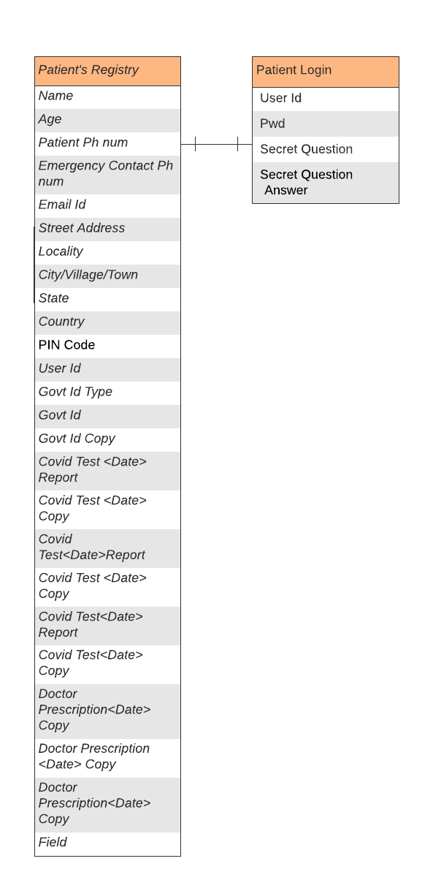
Patient Data Model

Slide 3
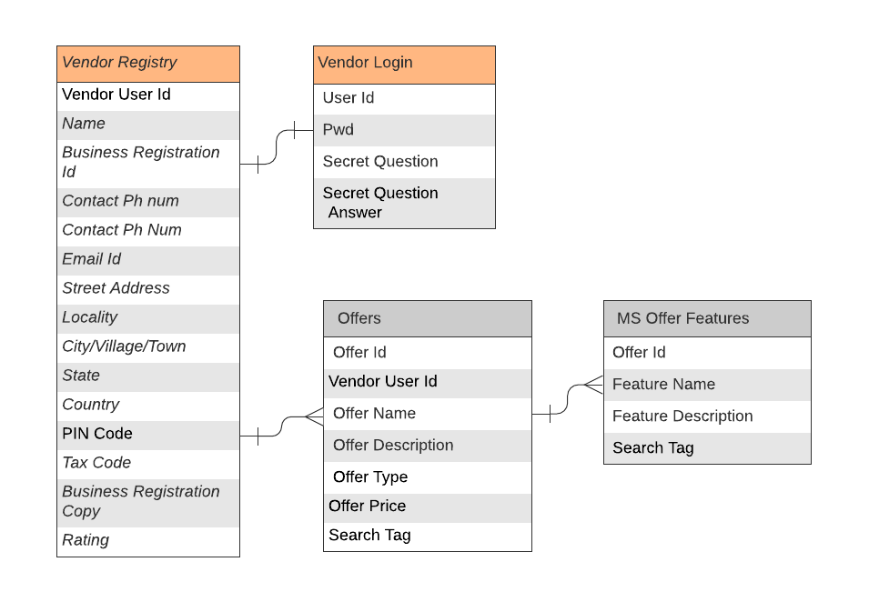
Vendor Data Model

Slide 4
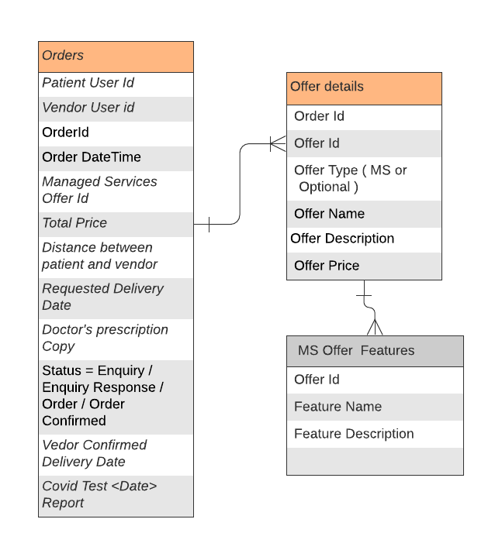
Order Data Model

Slide 5
Thank you
Visit us at www.techmahindra.com

